Slide 1
Musician Booking App Usability Study
20/02/2021
UX Analysis Team
Vijay, UX Designer

Slide 2
Table of Contents
Section 1 Study Details
Section 2 Themes
Section 3 Insights & Recommendations

Slide 3
Study Details

Slide 4
Project Background
We’re creating a Musician Booking app for a wedding venue to attract and retain customers in our online system. We wants to know whether the Musician band Pre-Booking task is simple and easy to complete. We are trying to learn what stops users from completing the task and what needs to be added to make users feel satisfied in their action. We also actively looking for ways to improve experience by reducing the time taken to accomplish the task.

Slide 5
Study Details
Research Questions
Participants
Methodology
What can we learn from the user flow, or the steps that users take, to Pre-book a musician’s band?
Are there parts of the user flow where participants get stuck?
Do users think this feature is helpful and/or useful?
Are there design changes we can make to improve the user flow by providing additional features?
5 participants
Professional Wedding Planners, Event Organizers & Young People
Two males, two females, and one nonbinary individual, aged 18 to 65 years old
One user of assistive technologies (keyboard, screen reader)
Location: India, remote (each participant will complete the study in their own home)
Date: Sessions will take place during the week of March 1-5, 2022
Length: Each session will last 5 to 10 minutes, based on a list of prompts
$15 Compensation

Slide 6
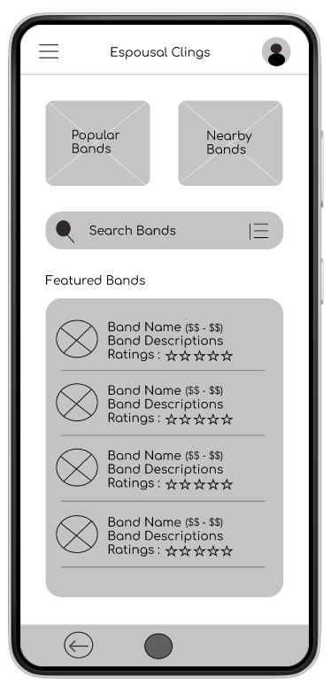
Prototype Tested
The low-fidelity app prototype for Espoual Clings App was tested and can be viewed here.

Slide 7
Themes

Slide 8
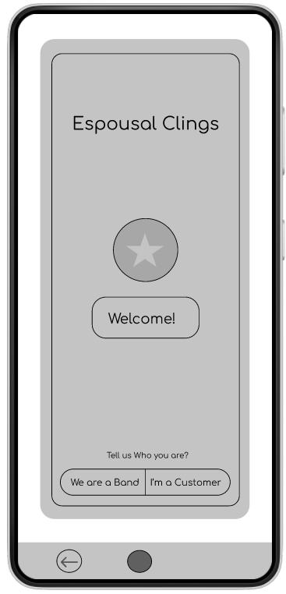
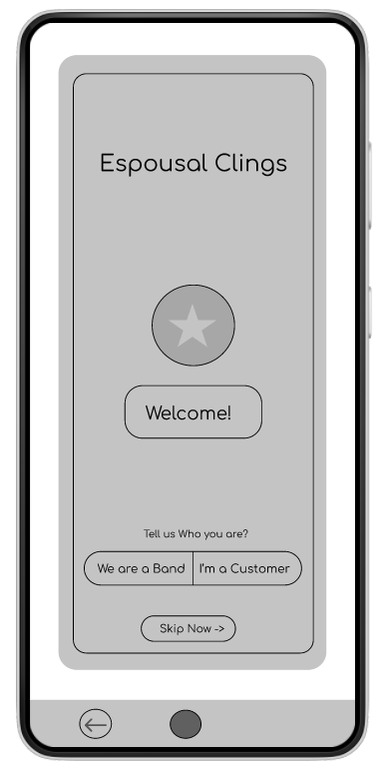
People want Skip Now feature at the Beginning
Supporting evidence from the usability study.
4 out of 5 total participants said they wanted to skip the sign up process before accessing the bands list
3 out of 5 total participants expressed a desire to sign up, if they found their preferred band
“I am expecting to skip the sign up option, am willing to browse the bands at first”
— Aishwarya Seji, Intern who is looking for bands for their wedding, India
a
Before After

Slide 9
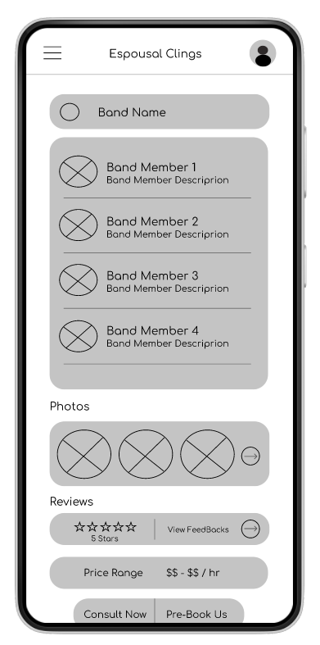
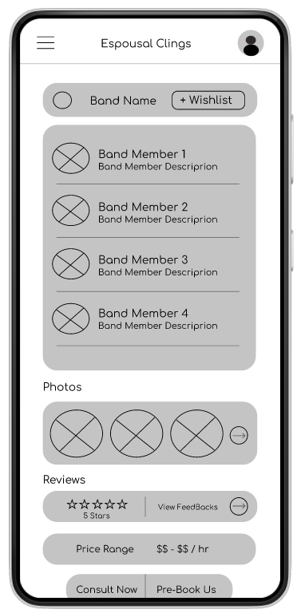
People want Wishlist Option
Supporting evidence from the usability study.
5 out of 5 total participants said they wanted the wishlist to add their preferred musician bands to look upon later.
4 of those participants said that wishlist will help them to compare the bands that they have chosen.
“I’m frustrated to compare the bands, so I would really like the option to save my preferred band to choose later.”
— Arvind Gupta, Wedding Planner, India
a
Before After

Slide 10
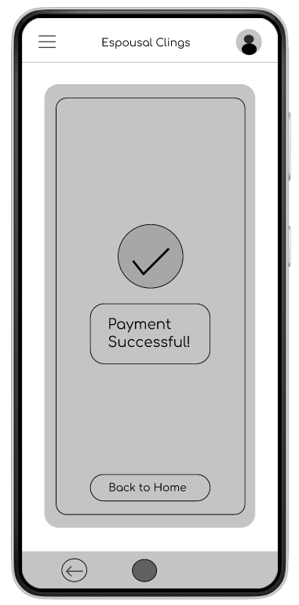
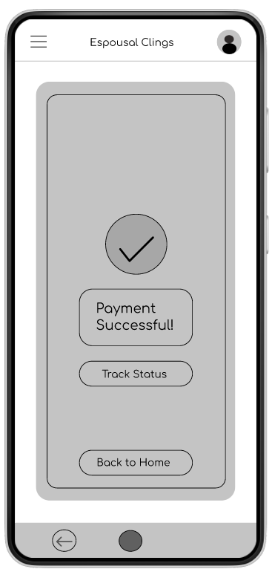
People want to know Band’s Confirmation Status
Supporting evidence from the usability study.
4 out of 5 total participants said they wanted to know the status of their bands after payments
“Just want to know if they are coming for sure, after a pre-booking.”
— Arvind Gupta, Wedding Planner, India
a
Before After

Slide 11
Insights & Recommendations

Slide 12
Research insights & Brief Review
Band’s Confirmation status
Skip Now Option
Wishlist Feature
Users need a way to skip the sign-up process before getting to the homepage.
Users need wishlist option to save and compare their preferred bands later..
Users need a way to know if the band accepted their invite.

Slide 13
Recommendations
Add a “Skip Now” option in the Welcome Page so users can get to the homepage quickly.
Add a “Wishlist” feature in the app so users can add their preferred bands for pick and compare later.
Add a way for users to know the status of their bands confirmation for the event.

Slide 14
Next Steps
Looking Forward to build the additional features and options in the prototypes to improve user experience and achieve research goals
Moving the project to the High-Fidelity Design and Prototype Phase
Acknowledgement :
Vijay V. UX Designer
Srigiri T UX Researcher

Slide 15
Thank you!

